Slide 1
COVID-19: Modeling In-Host Viral and Innate Immune System Dynamics
ENGN 2911R
Kento Abeywardane, Benjamin Homer, Adam Spooner

Slide 2
Motivation
Predict viral load progression of COVID-19 infection
Assume to be restricted to lung cavity
Attempt to capture immune response
More detailed viral load models allow for better understanding of the impact of potential therapeutics and future vaccinations
Notes:
Kento

Slide 3
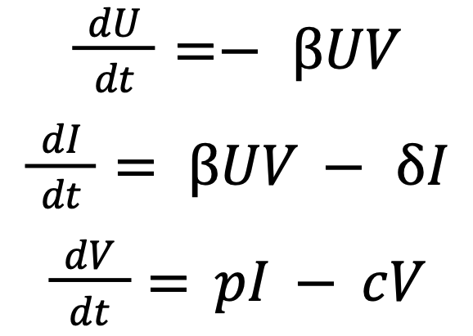
Background (General Model)
U
I
V
elimination
Common in-human models follow similar structure to SIR
Variable | Definition
U | Target (Lung) cells
I | Infected cells
V | Virions
Notes:
Kento
Literature has a lot of different types of models which try to model different things, but this is the basic one.
Some do target cell model, Immune response, and even within-cell kinetics (transcription/translation rates of RNA/DNA, etc)
ß = Rate of viral infection (rate of infection of target cells)
∂ = death rate of infected cells
p = virion production rate
c = clearance rate of virions (whether it be cell death, virion death, or immune response) → lumped param

Slide 4
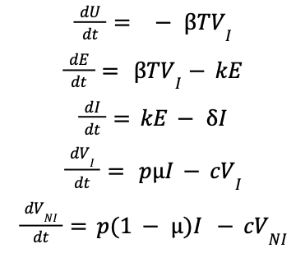
Model - Target Cell Model
V_{I}
elimination
U
E
I
V_{NI}
elimination
This model incorporates more realistic compartments
Variable | Definition
U | Target (Lung) cells
E | Latent cells
I | Infected cells
V_{I} | Infectious Virions
V_{NI} | Non-infectious Virions
Marc et al
Notes:
Ben
ß = Rate of viral infection (target → latent phase)
k = rate of eclipse to infected cells (rate of activation)
∂ = death rate of infected cells
p = virion production rate
µ = proportion of virions that actually infect other cells
(1-µ) → rest of the virions are noninfectious
c = clearance rate of virions (whether it be cell death, virion death, or immune response) → lumped param

Slide 5
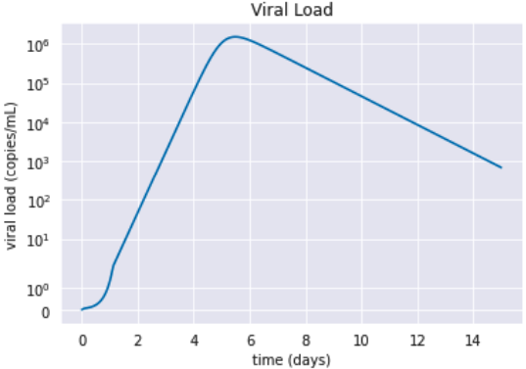
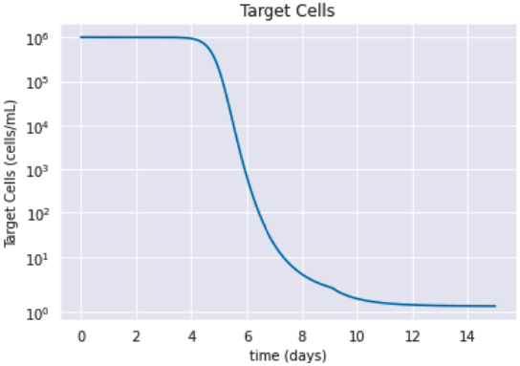
Model: Target Cell Perspective
Models viral load well relative to experimental data
Target Cells hit very hard
Almost all die
No regeneration
No carrying capacity
Viral Production Proportional to productive infecting cells.
Notes:
Ben

Slide 6
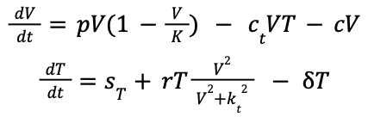
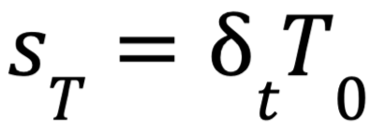
Model: T-cell Kinetics
T
V
elimination
This model incorporates T-cell immune response
Only models viral load and T-cell count
Accounts for carrying capacities of each variable
Variable | Definition
V | Virions
T | T-cells
Blanco-Rodríguez et al
Notes:
Adam
Model used for T cells
represent the interaction between SARS-CoV-2 infection and immune response dynamics exclusively modeling number of CD8+ T cell
p - Virus replication rate
K - Maximum virions
cT - rate of killing infected cells by T cells
c - clearance rate
deltaT - T cell half life
ST - new T cell production
r - rate of activation of T cell proliferation by V
Kt - activation of T cell proliferation by the virus follows a log-sigmoidal form with half saturation constant kT. The coefficient m relates to the width of the sigmoidal function.

Slide 7
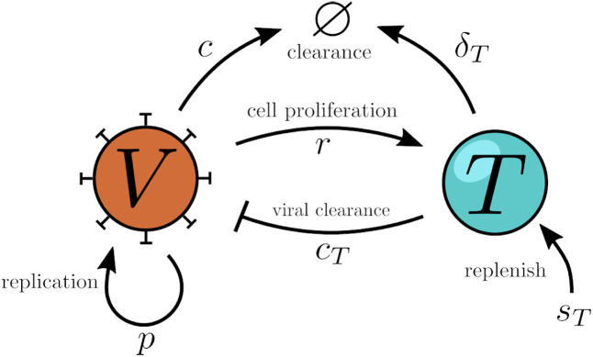
1.
Blanco-Rodríguez R, Du X, Hernández-Vargas E. Computational simulations to dissect the cell immune response dynamics for severe and critical cases of SARS-CoV-2 infection. Comput Methods Programs Biomed. 2021;211:106412. doi:10.1016/j.cmpb.2021.106412

Slide 8
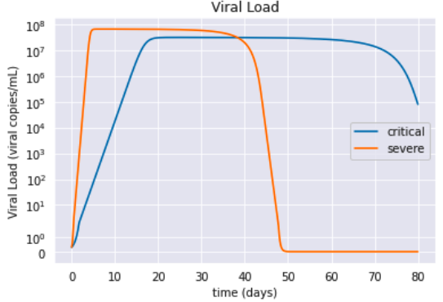
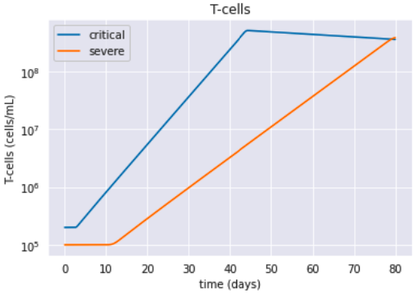
Model: T-Cell Kinetics
Carrying capacity
Viral production is proportional to the amount of virus
Is not as accurate for virus counts, however, matches expectations for T-Cells well.
Notes:
Adam
Graphs made for Viral load and T cell amount vs time
Two conditions produced to replicate the paper of interest one with severe and one with critical conditions
These were modeled in the parameters with severe cases having more extreme value of p, ct, and r respectively
Peak of the graphs are pretty accurate for values but the virions should be cleared faster, peak value should not stabalize for 40+ days would be insane super virus

Slide 9
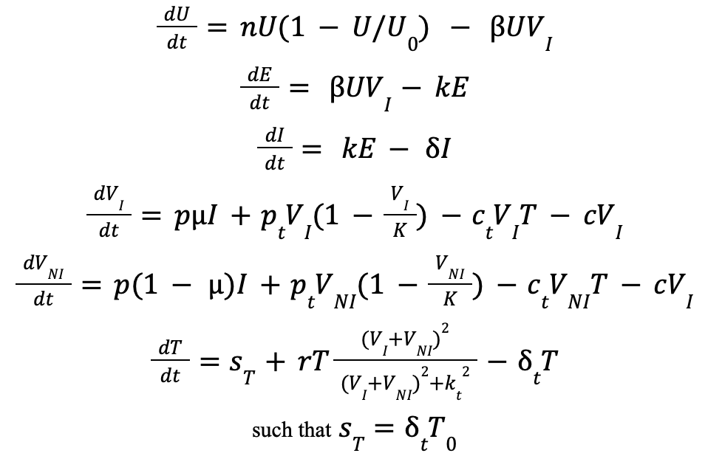
Novel Model
elimination
V_{I}
U
E
I
T
V_{NI}
elimination
A combination of Models 1 and 2 with important modifications
Incorporation of carrying capacities
Notes:
Kento
n = lung cell replication rate
U0 = target cell carrying capacity (initial target cell population)
ß = rate of viral infection of target cells
k = rate of eclipsed to productive phase
∂ = death rate of infected cells
p = cellular viral replication rate
µ = fraction that become infectious virions
pt = viral replication rate with relation to carrying capacity
K = virion carrying capacity
c = clearance rate of virions (natural death)
ct = clearance rate due to T-cells/immune response
∂t = replication rate of T-cells
r = T-cell Proliferation Rate
kt = half saturation constant for carrying capacity of T-cells

Slide 10
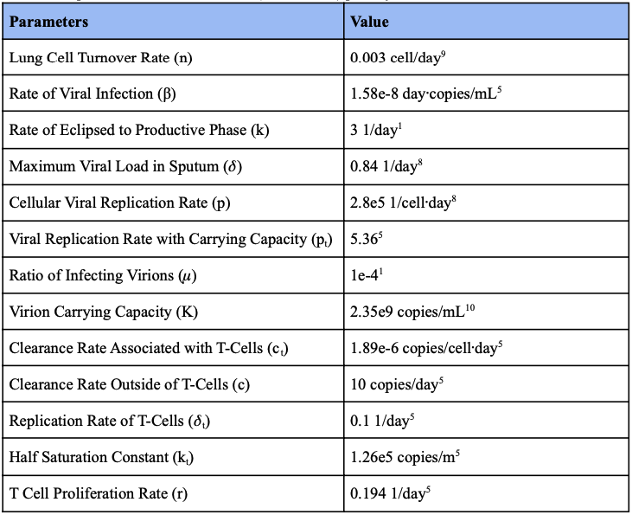
Parameter Selection
Determining parameters was significantly challenging
All drawn from literature
fitted from data
experimental
Notes:
Kento
-Finding parameters was especially difficult, had to use parameters from different sources and often they were specifically fitted to individual patients rather than averages due to massive variance in patient results
-Parameters were either drawn experimentally when possible, or through model fitting of other models
-A major challenge was making sure the parameter values were in the right units that we needed b/c they often were sporadic or weren’t labeled with units

Slide 11
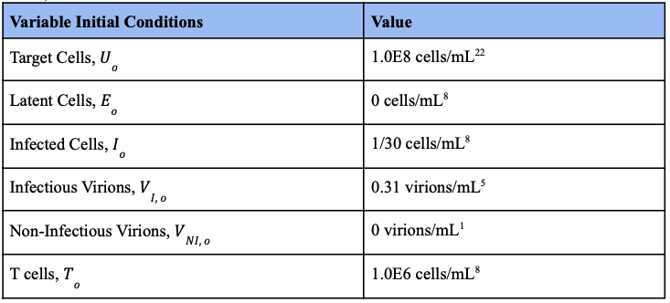
Initial Conditions
Determined from other models
Assume initial viral load of infection to be 0.31 virions/mL
Notes:
Ben

Slide 12
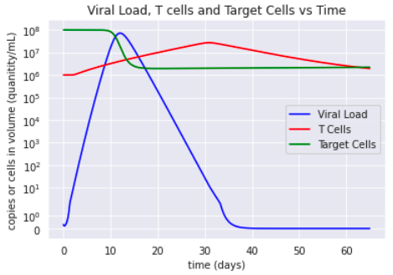
Results
Critical case analyzed
Peak of viral load just after 10 days. This is systematic peak (studies show that this happens after airway viral load peak).
T-cells peak a month after introduction to the virus
Notes:
Ben

Slide 13
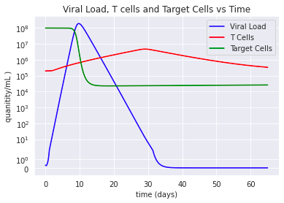
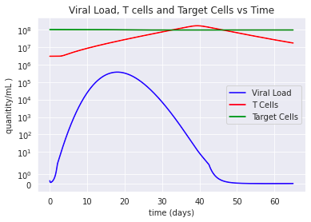
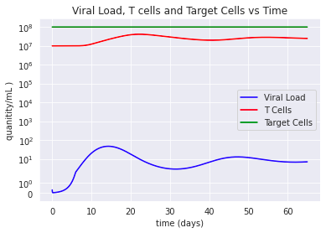
Results
T₀ = 2x10⁵
T₀ = 3x10⁶
T₀ = 1x10⁷
Increasing initial T cell count results in decreased viral load
Could be used in combination with transmissivity predictions to show vaccine efficacy as a function of T cells produced
Less sharp viral load
Threshold value found of initial T cells after which viral load equilibrates above 0
Small viral load results in slow and small T-cell response which is not enough to fully eliminate virions
Notes:
Adam
As a possible direction for this research we looked at the effect of varying To
In an invitro model this can be achieved through therapeutics as well as vaccination
With this model we can begin to find thresholds for the T cell increase in a therapeutic or vaccine needed to reduce the viral load to a threshold established by others for reducing transmissibility and optimizing recovery
T knot near 10^7 yields a equilibrated viral load above 10. We need to further investigate this phenomenon but initial investigation shows that the relative small initial viral load and high initial t cell concentration causes minimal T cell creation and activation and so viral load is only cleared to a lower limit of 10 virions however this is still only 10 virions as opposed to 100 million in To = 10^5

Slide 14
Discussion
Target cells die fast and end up with a very low number
Model indicates that T-cells return to normal levels as early as 2.5 months
This increase possibility of reinfection
Higher initial immune response leads to less cell death/orders of magnitude less virions
Model is useful at the individual level and population level
Notes:
Kento
-Target cells die very quickly with slow replication rate
-In other models, Target cells could be the determining factor of viral load. Which is why it was necessary for us to add various carrying capacity and replication rate terms
-T-cells return to normal levels as early as 2 and half months suggesting that there is a higher chance of reinfection after this time period
-If there is a higher initial immune response, there is less cell death and orders of magnitude less virions
-Note that people die due to high rates of T-cell activation where they cause inflammation problems in the lung,
but if there’s already a high population with slow increasing T-cell counts, it can control virions and body response
-model is useful at the individual level and the population level, we can relate this to how long someone is infectious
Limitations:
high variance in datasets and model fitting
almost impossible to validate model, had to compare to past models
There are other immune system aspects like memory B-cells that aren’t considered

Slide 15
Future Considerations
In-vivo studies
Incorporate
Adaptive immune system
B cells; Memory B cells; Memory T cells
Healing factors
Scarring
Better generalizable parameters
Notes:
Ben

Slide 16
Conclusion
Combining models can be successful
Parameters are very important
Likely the greatest weakness in model
Viral load is highest 10 days after exposure for severe cases
Improved parameters based on larger data sets can yield more predictive models
Combining an understanding of immune response (T cells) with previous work on transmissibility as a factor of viral load (Marc et al., Singanayagam et al.) can improve treatment and vaccinations
Singanayagam A, Hakki S, Dunning J, et al. Community transmission and viral load kinetics of the SARS-CoV-2 delta (B.1.617.2) variant in vaccinated and unvaccinated individuals in the UK: a prospective, longitudinal, cohort study. The Lancet Infectious Diseases. 2021;0(0). doi:10.1016/S1473-3099(21)00648-4
Marc A, Kerioui M, Blanquart F, et al. Quantifying the relationship between SARS-CoV-2 viral load and infectiousness. Cobey SE, Van der Meer JW, eds. eLife. 2021;10:e69302. doi:10.7554/eLife.69302
Notes:
Adam

Slide 17
Thank you!
Any questions?

Slide 18
References
Hernandez-Vargas EA, Velasco-Hernandez JX. In-host Mathematical Modelling of COVID-19 in Humans. Annu Rev Control. 2020;50:448-456. doi:10.1016/j.arcontrol.2020.09.0
Marc A, Kerioui M, Blanquart F, et al. Quantifying the relationship between SARS-CoV-2 viral load and infectiousness. Cobey SE, Van der Meer JW, eds. eLife. 2021;10:e69302. doi:10.7554/eLife.69302
Blanco-Rodríguez R, Du X, Hernández-Vargas E. Computational simulations to dissect the cell immune response dynamics for severe and critical cases of SARS-CoV-2 infection. Comput Methods Programs Biomed. 2021;211:106412. doi:10.1016/j.cmpb.2021.106412

